Slide 1


Muhammad Azhar Alam
20-May-2023

Slide 2

Outline
Executive Summary
Introduction
Methodology
Results
Conclusion
Appendix

Slide 3
Executive Summary
Summary of methodologies
Data Collection using API
Data Collection using Web Scraping
Data Wrangling
Exploratory Data Analysis (EDA) using SQL
Exploratory Data Analysis (EDA) with Visualization using Pandas and Matplotlib
Interactive Visual Analytics and Dashboard
Predictive Analysis
Summary of all results
EDA with visualization results
EDA with SQL results
Interactive map with Folium results
Plotly Dash dashboard results
Predictive analysis (classification) results

Slide 4
Introduction
Project background and context
SpaceX, a space transportation company, designs, manufactures and launches rocket into the space. Its ability to reuse the first stage has enabled it to launch rockets at a very low cost compared to other space agencies. Its Falcon 9 rocket which costed just 62 million dollars
Problems you want to find answers
Parameters to check successful rocket landing
Success rate of such landing
To determine operating procedures for successful landing

Slide 5

Section 1

Slide 6
Methodology
Executive Summary
Data collection methodology:
Data was collected using SpaceX REST API and web scrapping from Wikipedia
Perform data wrangling
Data was processed using one-hot encoding for categorical features.
Perform exploratory data analysis (EDA) using visualization and SQL
Perform interactive visual analytics using Folium and Plotly Dash
Perform predictive analysis using classification models
Logistic Regression, SVM, Decision Tree etc. were used

Slide 7
Data Collection
Data was collected using SpaceX API.
Content was decoded using .json() function and further normalization was done using .json_normalize() to turn it into pandas dataframe.
Data Cleaning was done to target empty data cells
BeautifulSoup was used for Web Scraping for Falcon 9 launch records.
Records were extracted as HTML tables using parser and then converted into pandas data frame.

Slide 8
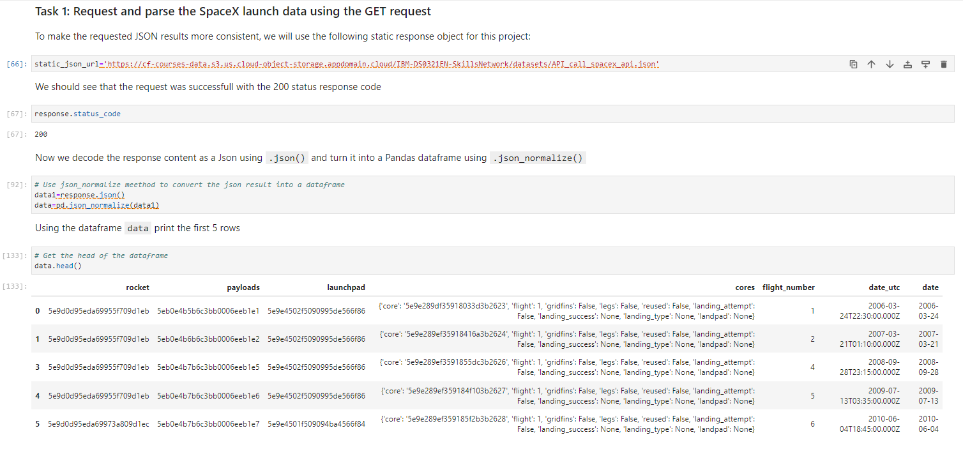
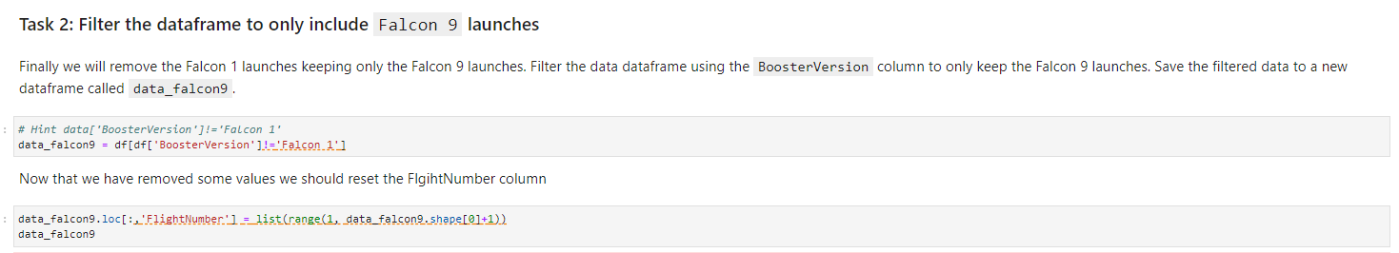
Data Collection – SpaceX API
We used the get request to the SpaceX API to collect data, clean the requested data and did some basic data wrangling and formatting.
https://github.com/azharalam94/IBM-Applied-Data-Science-Capstone-Project/blob/b179de166ad84e42e72699bf89a1ce1546b9d3b3/Data%20Collection%20API.ipynb

Slide 9
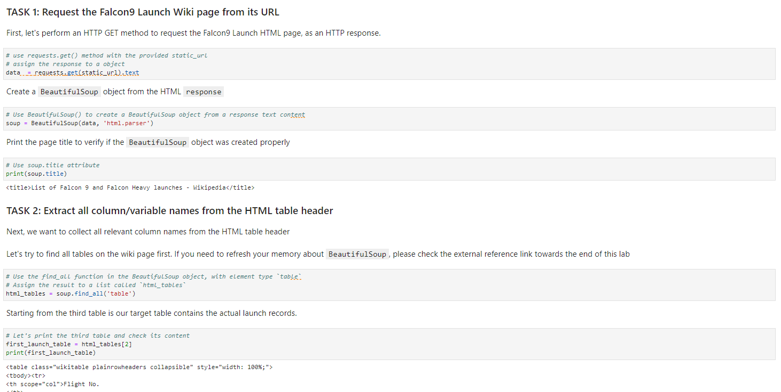
Data Collection - Scraping
Web Scraping was done using Beautiful object.
Table was parsed using html parser.
https://github.com/azharalam94/IBM-Applied-Data-Science-Capstone-Project/blob/766e1cfb0b7f94daa0c093e2ee1d9233c3dd5281/Data%20Collection%20Web%20Scraping.ipynb

Slide 10
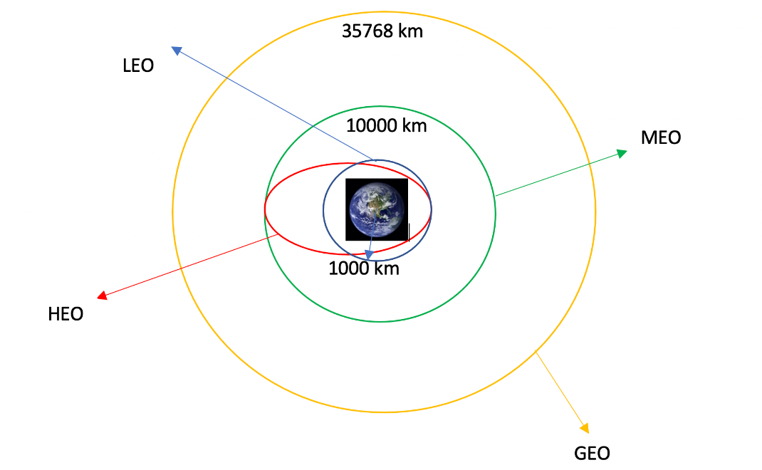
Data Wrangling
Calculated site launches and frequency of each orbit occurrence.
We calculated the number of launches at each site, and the number and occurrence of each orbits
Outcome label results are converted to CSV.
https://github.com/azharalam94/IBM-Applied-Data-Science-Capstone-Project/blob/766e1cfb0b7f94daa0c093e2ee1d9233c3dd5281/Data%20Wrangling.ipynb

Slide 11
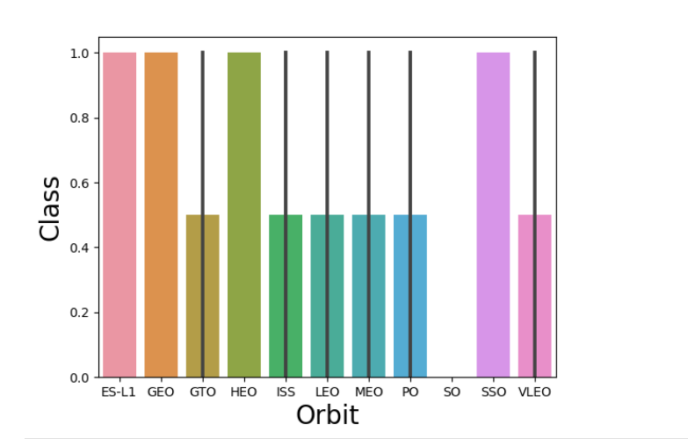
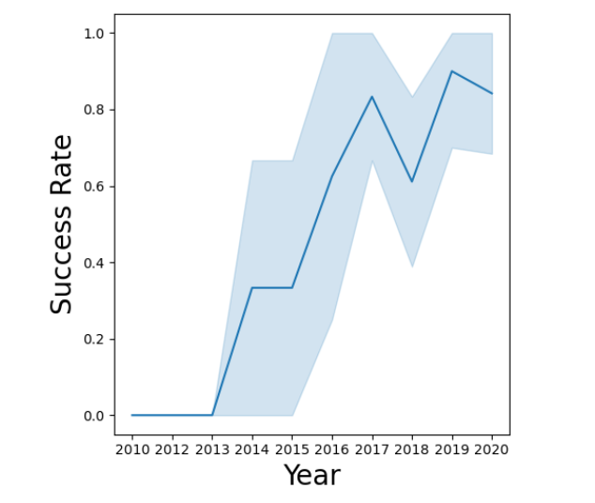
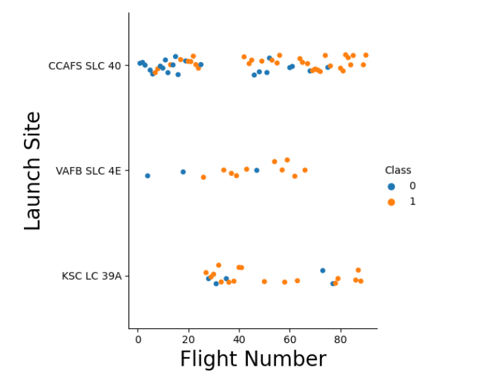
EDA with Data Visualization
Data is visualized considering different parameters like Flight Number Vs Launch Site, Success Rate Vs Year, Class Vs Orbit etc.
https://github.com/azharalam94/IBM-Applied-Data-Science-Capstone-Project/blob/766e1cfb0b7f94daa0c093e2ee1d9233c3dd5281/EDA%20with%20Data%20Visualization.ipynb

Slide 12
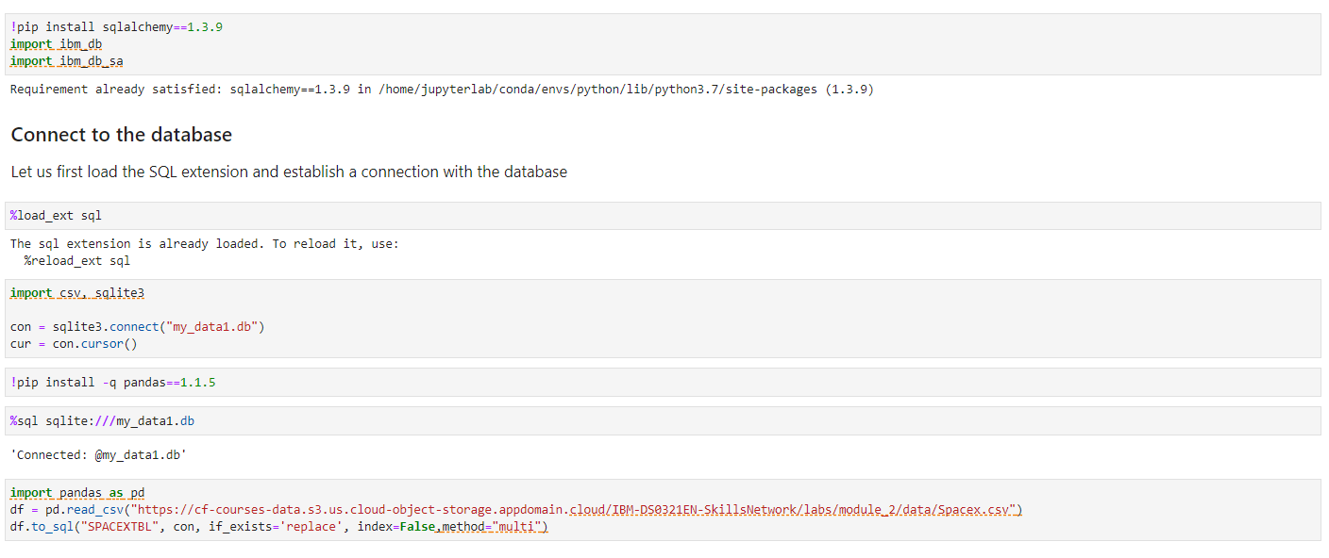
EDA with SQL
We used Jupyter notebook to write SQL queries.
https://github.com/azharalam94/IBM-Applied-Data-Science-Capstone-Project/blob/766e1cfb0b7f94daa0c093e2ee1d9233c3dd5281/EDA%20with%20SQL.ipynb

Slide 13
Build an Interactive Map with Folium
We assigned the feature launch outcomes (failure or success) to class 0 and 1.i.e., 0 for failure, and 1 for success.
Using the color-labeled marker clusters, we identified launch sites have probability of relatively high success rate.
We calculated the distances between a launch site to its proximities. We answered some question for instance:
Are launch sites near railways, highways and coastlines.
Do launch sites keep certain distance away from cities.
https://github.com/azharalam94/IBM-Applied-Data-Science-Capstone-Project/blob/766e1cfb0b7f94daa0c093e2ee1d9233c3dd5281/Interactive%20Visual%20Analytics%20with%20Folium%20lab.ipynb

Slide 14
Build a Dashboard with Plotly Dash
Dashboard was interactive and offered visuals of different launch sites
Pie charts and scatter plots were plotted with different booster versions.
https://github.com/azharalam94/IBM-Applied-Data-Science-Capstone-Project/blob/766e1cfb0b7f94daa0c093e2ee1d9233c3dd5281/spacex_dash_app.py

Slide 15
Predictive Analysis (Classification)
Numpy and Pandas libraries are used.
Machine Learning models
Worked on model improvement
We found the best performing classification model.
https://github.com/azharalam94/IBM-Applied-Data-Science-Capstone-Project/blob/766e1cfb0b7f94daa0c093e2ee1d9233c3dd5281/Machine%20Learning%20Prediction.ipynb

Slide 16
Results
Exploratory data analysis results
Interactive analytics demo in screenshots
Predictive analysis results

Slide 17

Section 2

Slide 18
Flight Number vs. Launch Site
Plot shows relationship between Flight Number and Launch Site

Slide 19
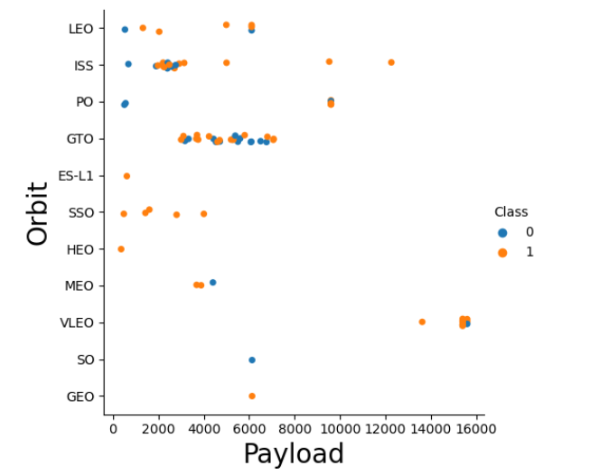
Payload vs. Launch Site
Probability of success rate is higher after 7000 kg
There is no clear pattern to say the launch site is dependent to the payload mass for the success rate

Slide 20

Success Rate vs. Orbit Type
From the plot, we can see that ES-L1, GEO, HEO, SSO, VLEO had the most success rate.

Slide 21
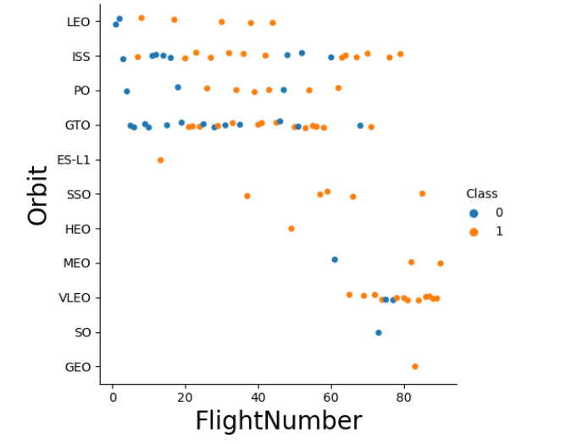
Flight Number vs. Orbit Type
Plot shows Flight Number vs. Orbit type. We observe that in the LEO orbit, success is higher related to the number of flights whereas in the GTO orbit, there is no relationship between flight number and the orbit.

Slide 22
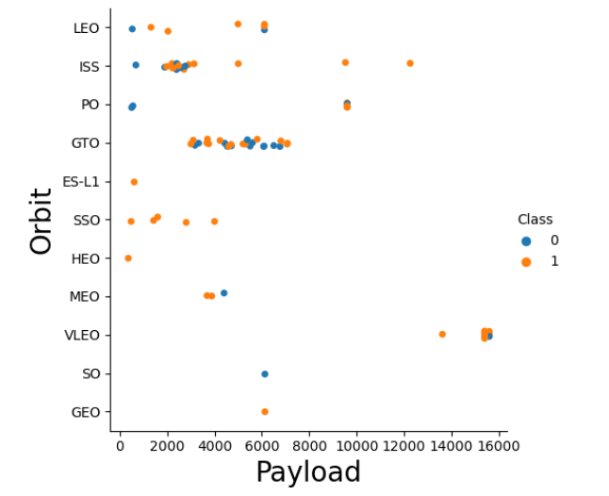
Payload vs. Orbit Type
We can observe that with heavy payloads, the successful landing are more for PO, LEO and ISS orbits.

Slide 23

Launch Success Yearly Trend
From the plot, we can observe that success rate since 2013 kept on increasing till 2020.

Slide 24
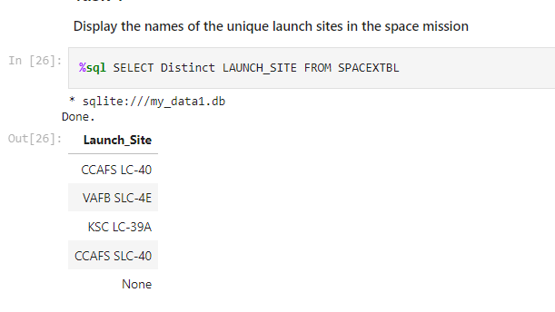
All Launch Site Names
Used the key word DISTINCT to show only unique launch sites from the SpaceX data.

Slide 25
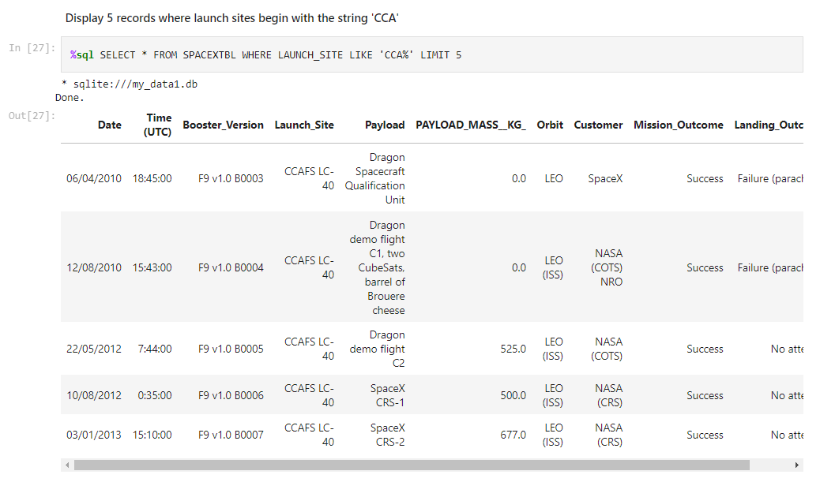
Launch Site Names Begin with 'CCA'
Query to display 5 records where launch sites begin with `CCA`.

Slide 26
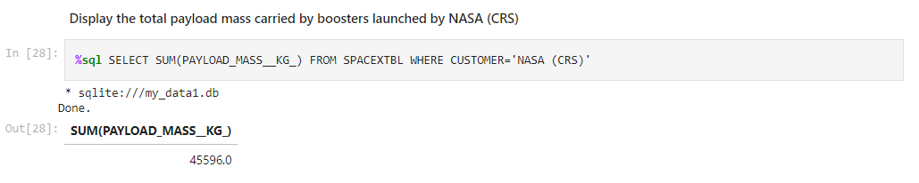
Total Payload Mass
Tpayload carried by boosters from NASA is 45596

Slide 27
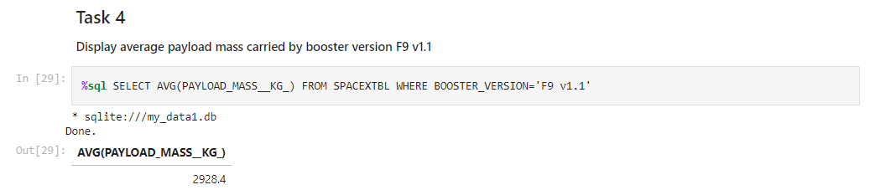
Average Payload Mass by F9 v1.1
SQL query for Average Payload Mass carried by booster version F9 v1.1 as 2928.4

Slide 28
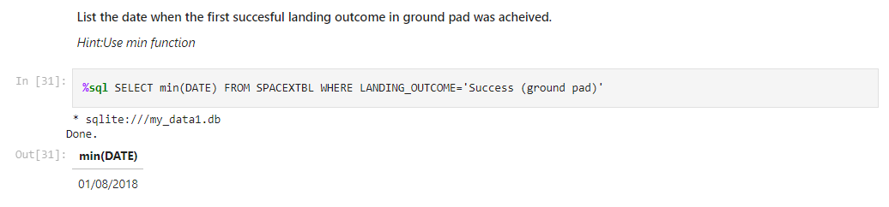
First Successful Ground Landing Date
First successful landing outcome on ground pad was 1st August 2018

Slide 29
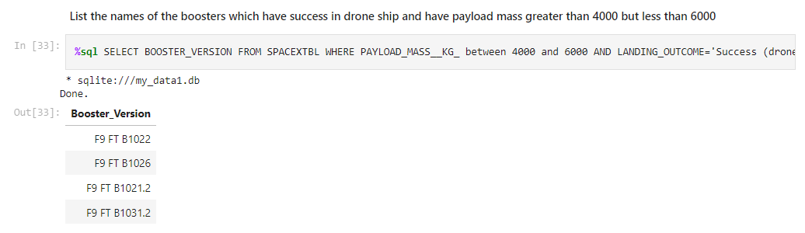
Successful Drone Ship Landing with Payload between 4000 and 6000
SQL query to filter ship landing between 4000 and 6000 is mentioned below.

Slide 30
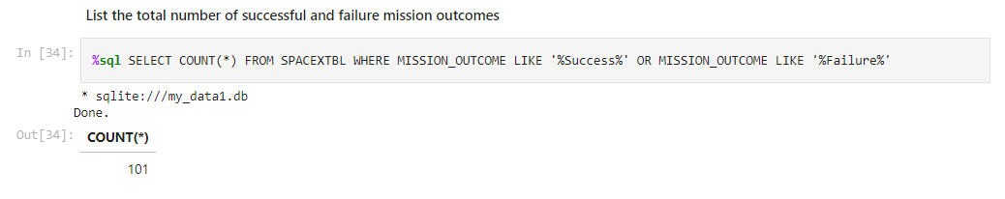
Total Number of Successful and Failure Mission Outcomes
Total count of Successful and Failure Mission Outcomes

Slide 31
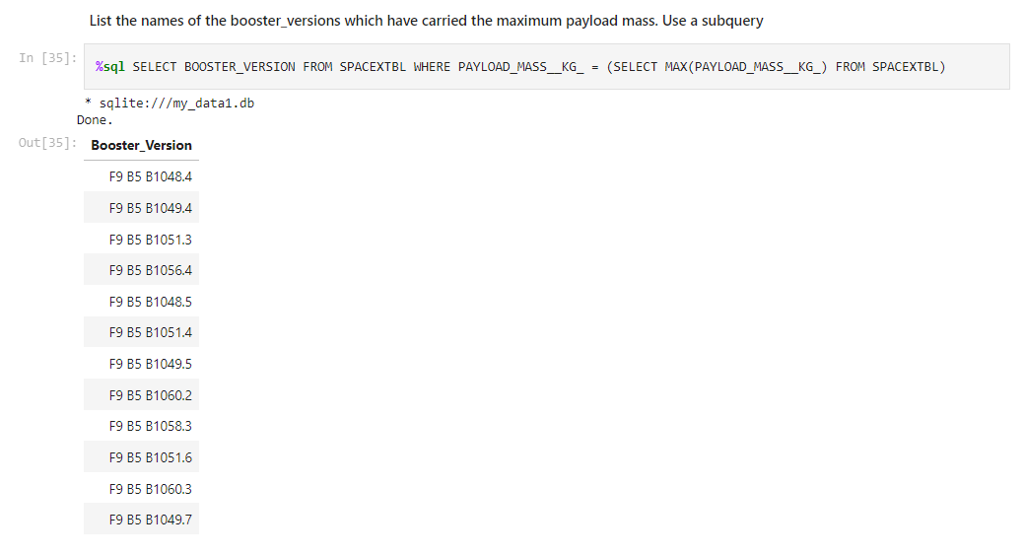
Boosters Carried Maximum Payload
List of Booster Carrying Maximum Payload

Slide 32
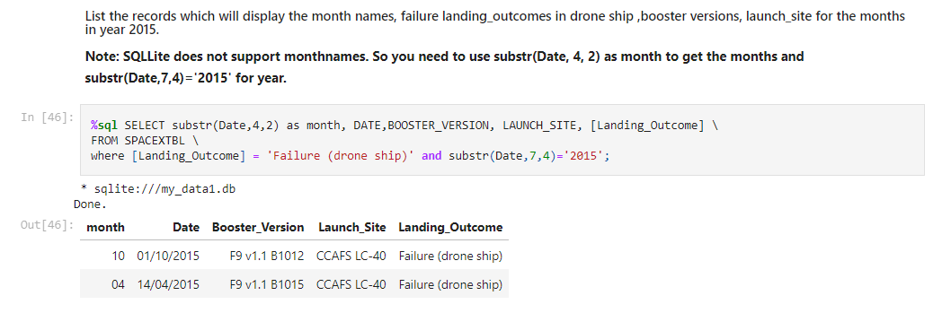
2015 Launch Records
SQL query containing substr() is used to query SPACEXTBL

Slide 33
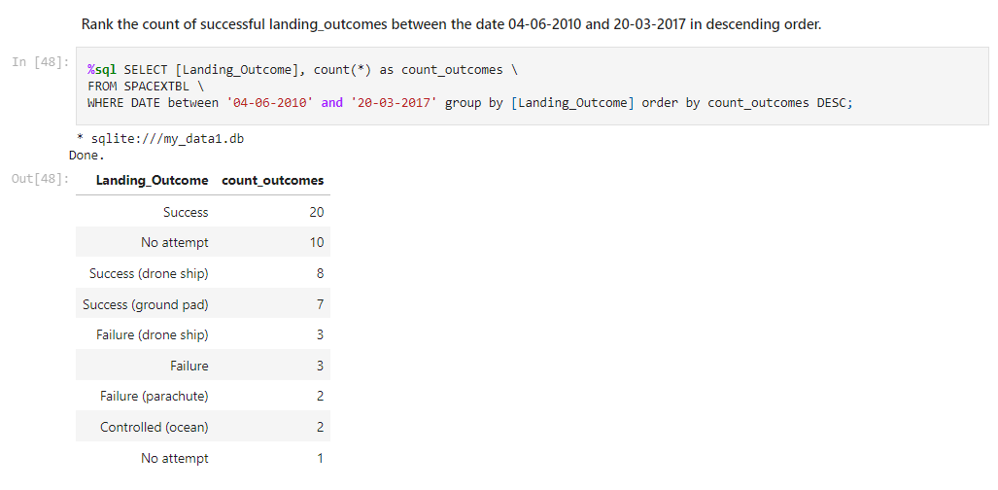
Rank Landing Outcomes Between 2010-06-04 and 2017-03-20
Landing Outcome is mentioned between the given period.

Slide 34

Section 3

Slide 35
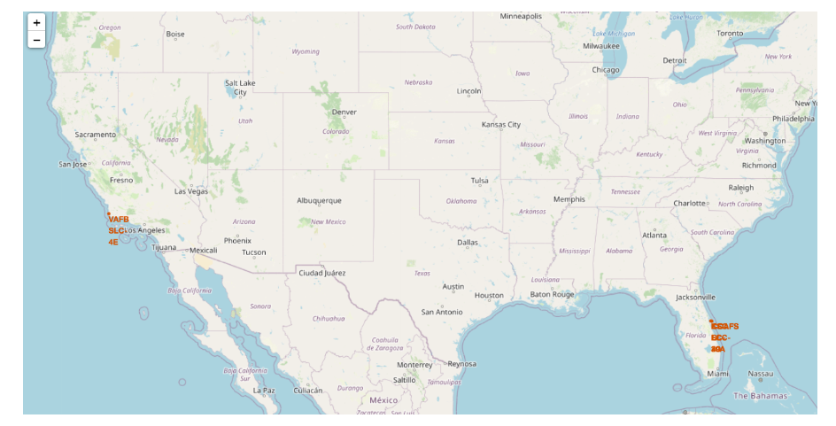
Launch sites
SpaceX launching site on extreme ends of the USA, Florida and California.

Slide 36
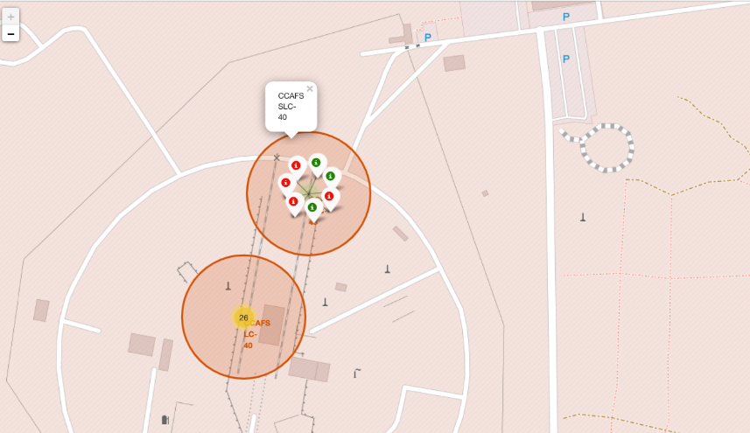
Labeling using markers
Launch sites, green shows successful launches whereas red shows failure.

Slide 37
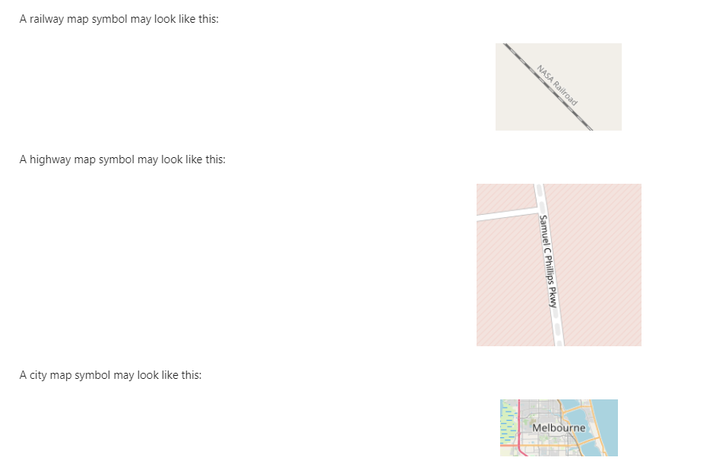
Symbolic Representation
A legend for elaboration of maps

Slide 38

Section 4

Slide 39

Pie chart showing success rates by sites
Replace <Dashboard screenshot 1> title with an appropriate title
Show the screenshot of launch success count for all sites, in a piechart
Explain the important elements and findings on the screenshot

Slide 40

Pie chart showing success and failure rates

Slide 41

Weighted Payloads
Replace <Dashboard screenshot 3> title with an appropriate title
Show screenshots of Payload vs. Launch Outcome scatter plot for all sites, with different payload selected in the range slider
Explain the important elements and findings on the screenshot, such as which payload range or booster version have the largest success rate, etc.

Slide 42

Section 5

Slide 43

Decision tree classifier is the model with the highest classification accuracy
Visualize the built model accuracy for all built classification models, in a bar chart
Find which model has the highest classification accuracy

Slide 44
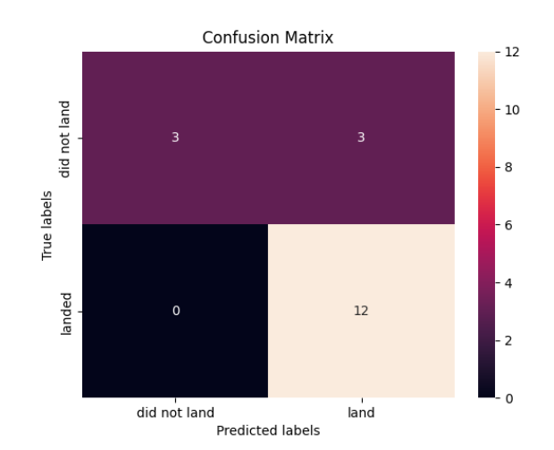
Confusion Matrix
Confusion matrix for the decision tree classifier shows that the classifier can distinguish between the different classes. The major problem is the false positives .i.e., unsuccessful landing marked as successful landing by the classifier.

Slide 45
Conclusions
low weighted payloads (which define as 4000kg and below) performed better than the heavy weighted payloads.
KSC LC-39A had the most successful launches of any sites.
SSO orbit have the most success rate; 100% and more than 1 occurrence
The Decision tree classifier is the best machine learning algorithm for this task

Slide 46


